Slide 1
Aggressive Behavior in Children
Ladesha Jenkins, Blaine Bateman, PhD, Dr. Torina Lewis, PhD
Clark Atlanta University, HBCU UP Program

Slide 2
Introduction
Children learn, adapt, and take on behaviors that are taught from the many influences that he/she may encounter. The number of influences that a person has is not limited to the family members in one’s house hold. A child’s many influence can include, but are not limited to, immediate family, friends, school, neighbors, celebrities, and the biggest of all the media. The media would be considered as all forms of communication outlets like the internet, social media, news media, print media, and in specific to this project video viewing and electronic games. The media can offer good and bad influences for all viewers watching it. It is a parent’s duty to protect the child from negative influences as much as possible to ensure healthy growth and implement good behavior.
The media can introduce children to early exposure of media violence. Early exposure to media violence is a contributing factor to the development of aggression. The aggression then could lead to aggressive and violent behavior in children. Children are increasingly becoming heavy media consumers. Research indicates that much of the media directed at children contains violent content. Early exposure to media violence could place both male and female children at risk for the development of aggressive and violent behavior in adulthood. Children that watch shows that have violence that is realistic, consistently repeated and unpunished, are more likely to imitate what they see. Children with emotional, behavioral, learning or impulse control problems may be more easily influenced by video aggressiveness. The impact of TV violence may show immediately in the child's behavior or may surface years later. Due to the media presenting violence at a very high level, scientists have found ways parents can protect children from excessive media violence. Each day there are multiple things and people that a child would observe where behaviors can be learned from. These multiple things would be considered as the factors of independent variables that affect behavior in children. In this project, the factors that are tested that affect behavior in children are electronics, siblings (older and younger), parental approach, and nutrition. These factors tend to be the major affects in children because these typically are things and people that the child would encounter every day. The examples set by adults, older siblings and children are the most powerful influences shaping a child's behavior and personality. Electronics a nutrition would be the next major influences on children behavior because electronic offer exposure to all types of human behavior from the negative to positive behavior. The elements or ingredients of a child's diet like thiamin treatment reverses aggressiveness in thiamin-deficient children, and sucrose and additives are suspected to induce hyperactivity.
Of all types of behavior a child can display, the focus of the project would be on aggressive behavior. The level of aggressiveness would be determined according to the different circumstances of the household that the child lives in. it is know that all people's circumstances are different or have their own uniqueness. At a general level, realistic scenarios or cases that are close to what a child's family can fit in are projected according to the different levels of the project. Being that children would be the main focus, parents would be the audience of this project. The purpose of the project would be to predict the level of aggression with these given levels according to each factor or independent variable.

Slide 3
Research Question
What are the most significant factors that affect aggressive behavior in children?

Slide 4


Independent Variables
Video Viewing
Electronic Games
Nutrition
Parental Approach
Siblings
Dependent Variable
Aggression

Slide 5
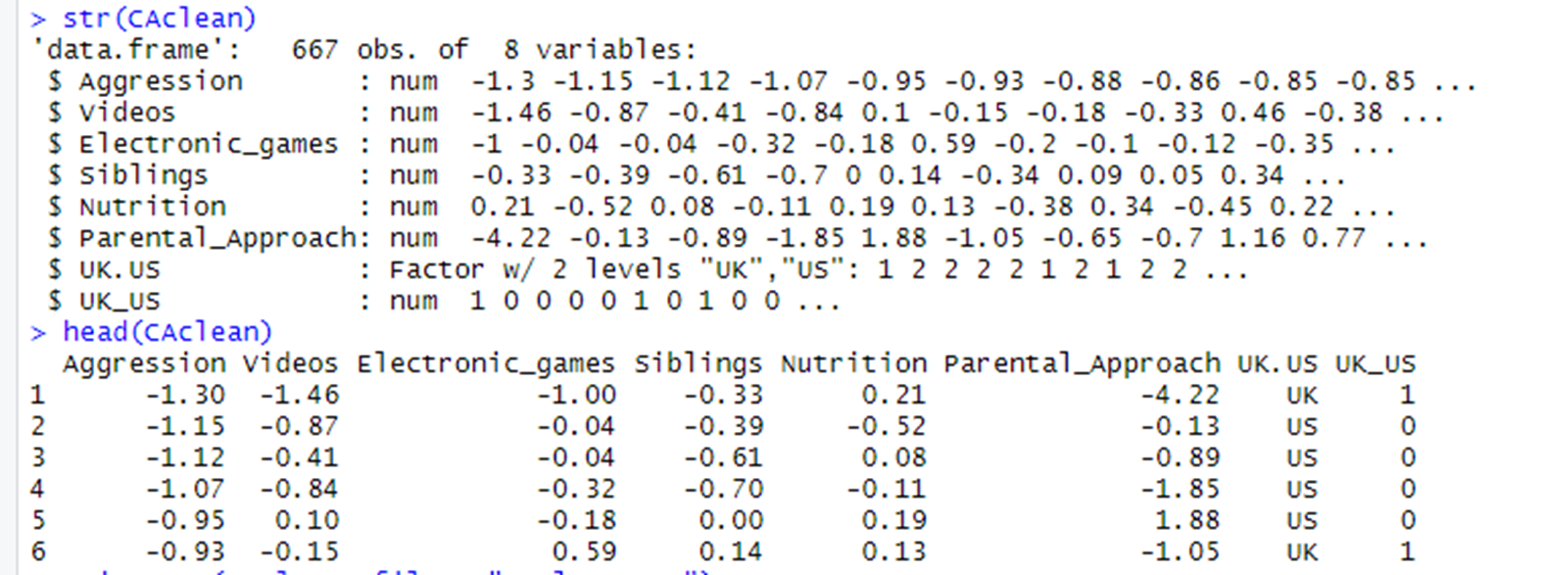
Cleaned Data Set
The original dataset from Kaggle user Johnathan A. To clean the dataset, column names were changed to more precise names and a column was added to give UK and the US numerical value using data wrangling techniques.

Slide 6
Data Wrangling Techniques
The original dataset was transformed into a clean dataset to be used for the research. The packages necessary for the code used were plyr, dplyr, tidyr, and readxl. The names of the variables in the original dataset were changed to more applicable names. Other variables were deleted since they were unnecessary for the models. Missing data were removed, and a column was added to distinguish between children in the United States (US) and the United Kingdom (UK). Numeric values of zero and one were assigned to the US and UK respectively. The head and structure function have been applied to the clean dataset

Slide 7
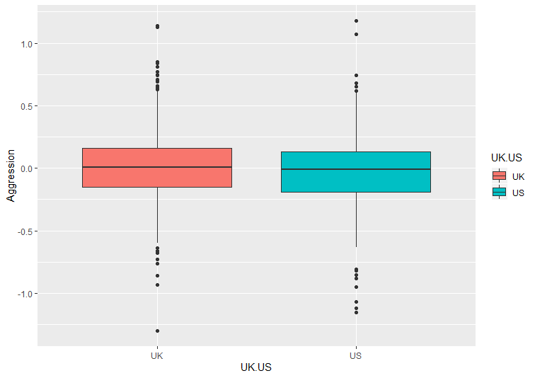
Figure 1 The boxplot shows that aggression level mean for UK is higher than in US.

Slide 8
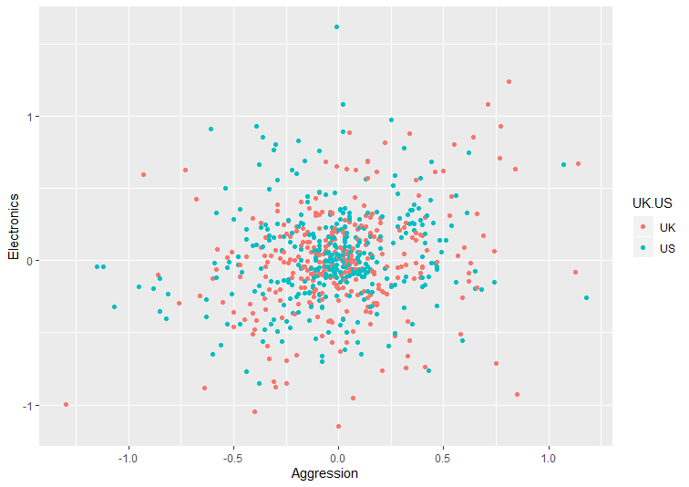
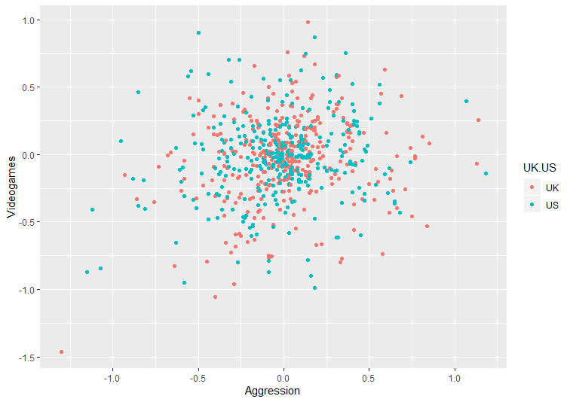
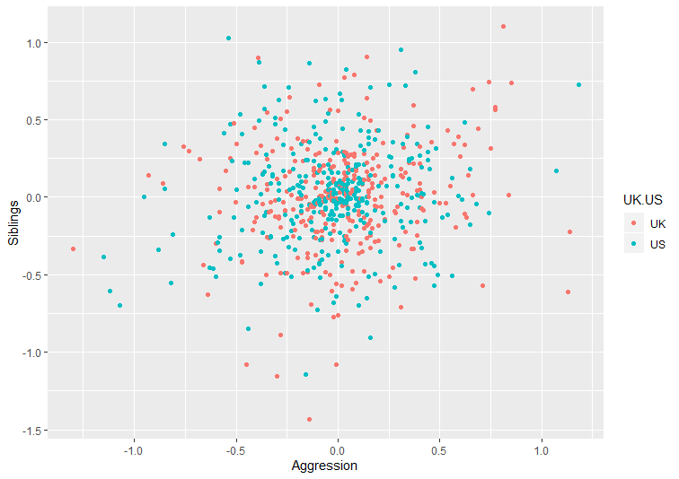
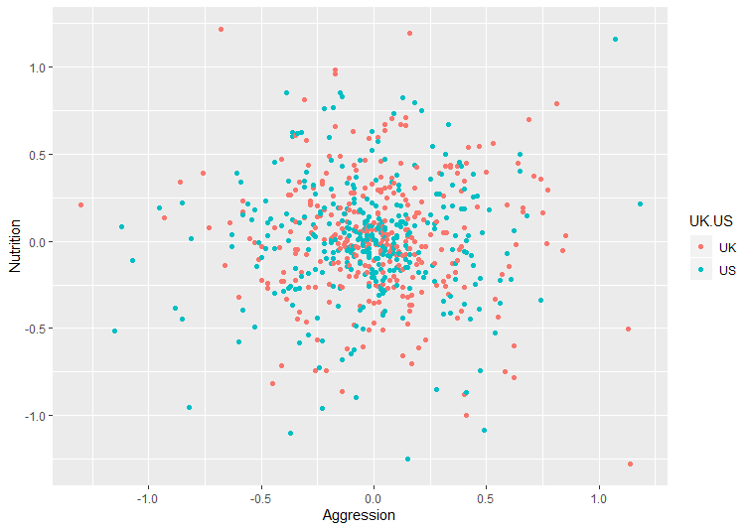
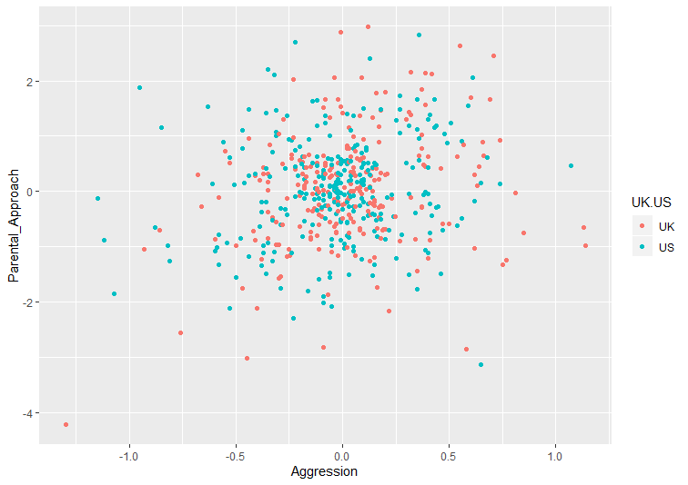
#1
#2
#3
In the first scatter plot, electronic games was compared to aggression, and it has a positive linear association between the two variables. In the second scatter plot, videos was compared to aggression, and it has a positive linear association between the two models. In the third scatter plot, siblings was compared to aggression, and it has a positive linear association between the two variables. The third scatter plot seems to have the highest positive linear slope due to the points on the scatter plot spreading from one side of the graph to the other. Also, it doesn’t have as many points focused or centered in the middle of the plot. In the fourth scatter plot, nutrition was compared to aggression, and it is hard to decipher whether or not it has a negative or positive linear association or no association between the two variables. If the scatter plot included a linear slope, it could possibly be a negative slope. In the final scatter plot, parental approach was compared to aggression, and it has a positive linear association between the two variables.
#4
#5

Slide 9
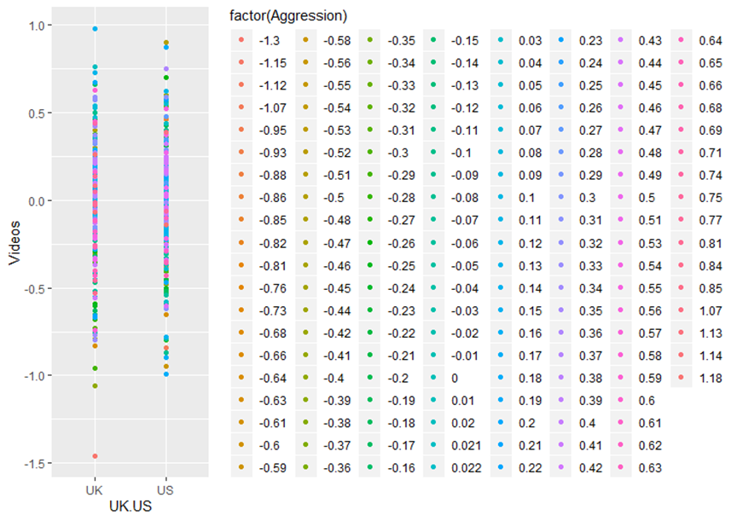
Figure 7
The boxplot of jitter points shows that Higher Video Viewing caused higher aggression levels in UK than in the US.

Slide 10
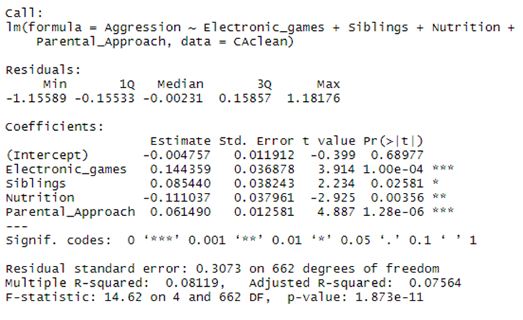
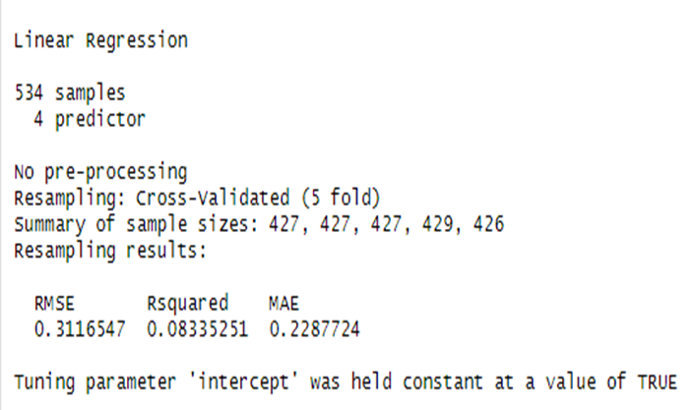
Statistical Analysis
The dataset had to be first split into 80 percent of the data (Training Set) and 20 percent of the data (Testing Set).
Training Set
Cross-Validation of Training Set
R-squared values are low , but the model is consistent with closely equivalent r-squared values before and after cross validation.

Slide 11
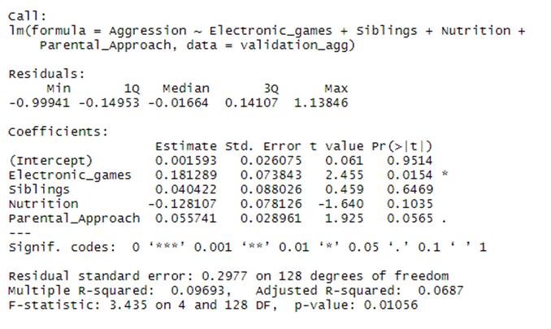
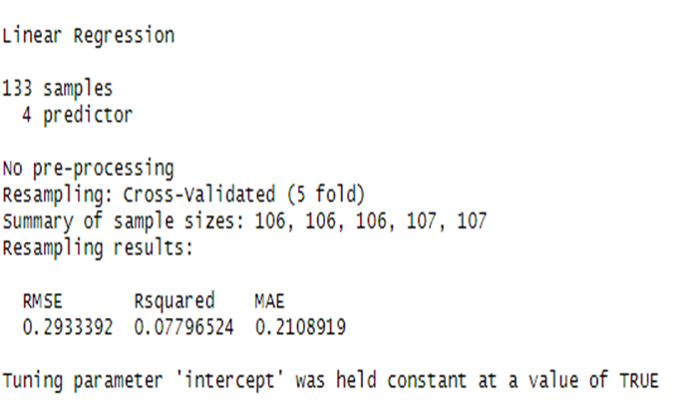
Statistical Analysis
The dataset had to be first split into 80 percent of the data (Training Set) and 20 percent of the data (Testing Set).
Testing Set
Cross-Validation of Testing Set
R-squared values are low , but the model is consistent with closely equivalent r-squared values before and after cross validation.

Slide 12
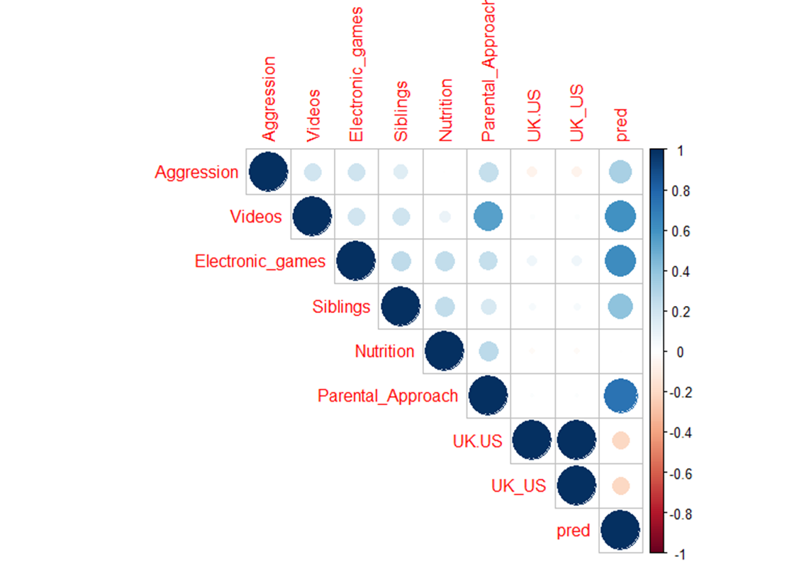
Results
The R-squared values of the models were not close to 1. Thus the models should be tweaked to return a higher R-Squared value.
After the variables in the model have been correlated, it is shown that each variable perfectly correlates to itself for each gives a value of 1, but there is not much correlation of one variable to the other variables. In making a prediction model, predictions would slightly correlate to each variable except nutrition in a predicted model.

Slide 13
Future Work
To enhance the model more variables and factors could be used to compare the aggression levels of children in each country. For example, different countries and factors like school and neighborhood ca be used to improve the accuracy of the projected aggression levels

Slide 14
Acknowledgements
I would like to acknowledge my Springboard mentor, Mr. Blaine Bateman, and my faculty mentor, Dr. Torina Lewis for their expressed support. This research opportunity was sponsored by the National Science Foundation

